Slide 1
CYBER SECURITY IN A NUTSHELL

Slide 2
—SOME RANDOM HACKER
“Security is an illusion
and
Privacy is a myth”
Quote
>> tv.ORF
P.100.7

Slide 3
TABLE OF CONTENTS
01
02
03
04
APT
SOCIAL ENGINEERING
What do you know about APT groups?
Did you know your brain can be hacked?
HARDWARE HACKING
ANTIVIRUS
Rubber ducky? WiFi pineapple? Strange.
Stay safe on the internet pls.
Table of contents
>>
P.100.2

Slide 4
01
ADVANCED PERSISTENT THREATS
CyberSEC
>> tv.ORF
P.100.3

Slide 5
INTRODUCTION
Advanced Persistent Threat (APT) groups are widely classified as organizations that lead, attacks on a country’s information assets of national security or strategic economic importance. They are eminent, dangerous and cause a lot of damage.
APTs don’t just target enemy nations. Large corporations are also targets for certain APT groups, and it’s absolutely crucial to catch APT operations before they can breach your perimeter. Once inside they deploy a wide range of methods to steal valuable information for internal intelligence, either to receive ransoms or for general sabotage (like shutting down enemy power grids).
CyberSEC
>> tv.ORF
P.100.3

Slide 6
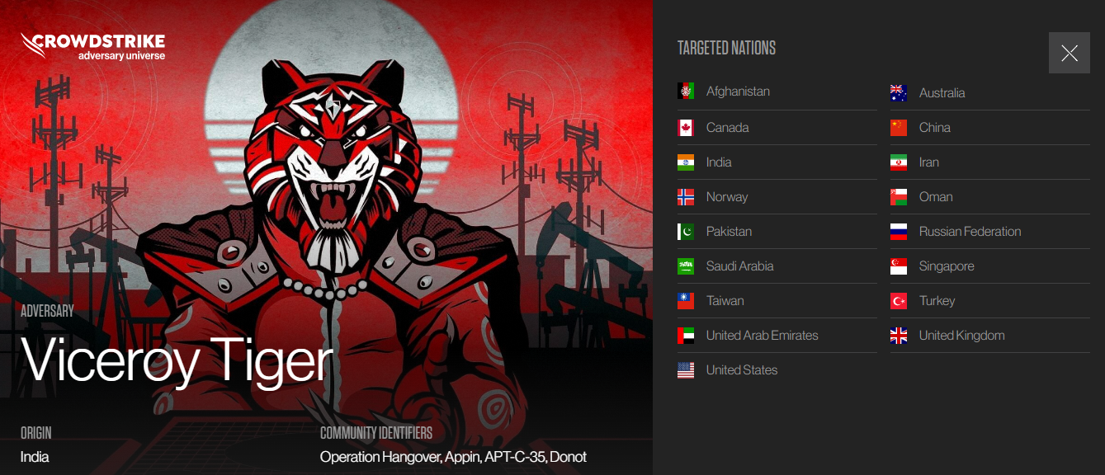

Slide 7


Slide 8


Slide 9


Slide 10
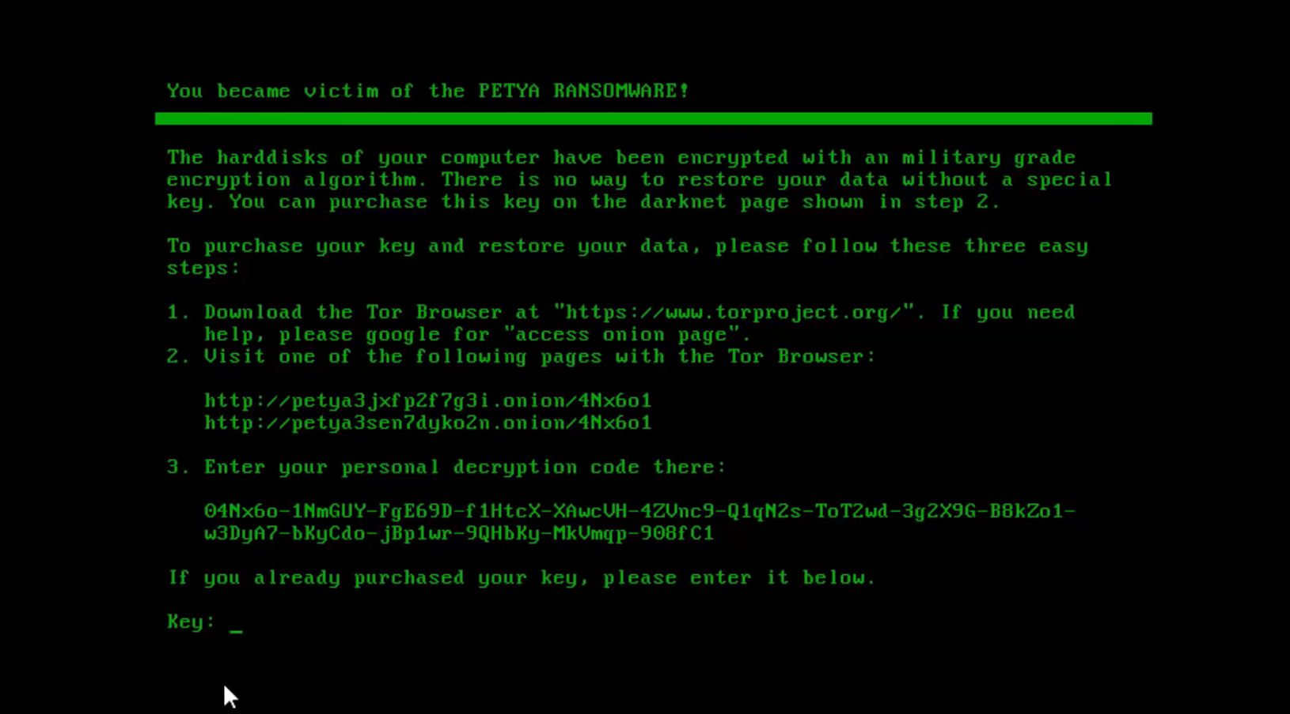

Slide 11
02
SOCIAL
ENGINEERING
CyberSEC
>> tv.ORF
P.200

Slide 12
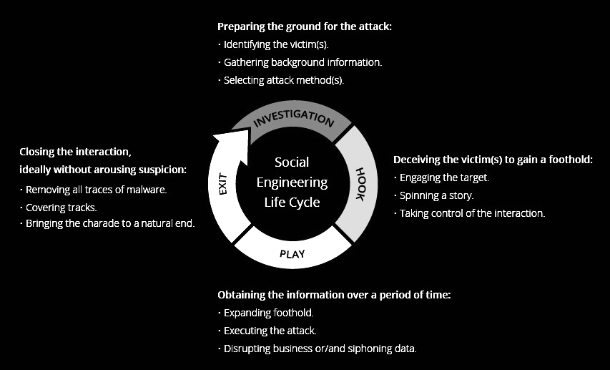
INTRODUCTION
CyberSEC
>> tv.ORF
P.100.3

Slide 13








STORY TIMEEE!!
CyberSEC
>> tv.ORF
P.100.5

Slide 14


STORY TIMEEE!!
CyberSEC
>> tv.ORF
P.100.5

Slide 15
HARDWARE HACKING
03
CyberSEC
>> tv.ORF
P.100.3

Slide 16
INTRODUCTION
Hardware hacking is the modifying of electronics into a form that was not originally intended. This modifying of hardware affects the functionality, components enclosed within the hardware or even the behavior of the hardware equipment itself. These types of modifications allow hackers to compromise systems by simply plugging in modified or hacked devices or tools.
CyberSEC
>> tv.ORF
P.100.3

Slide 17

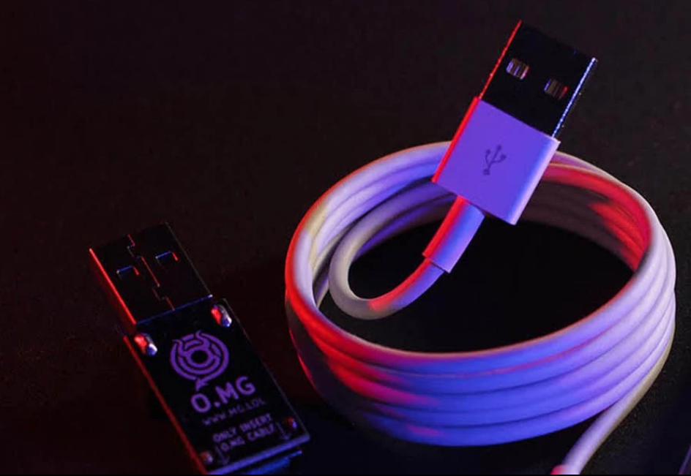

Slide 18
ANTIVIRUS
04
CyberSEC
>> tv.ORF
P.100.3

Slide 19
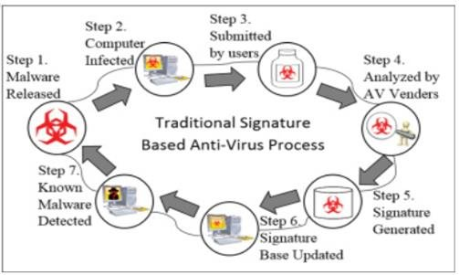
INTRODUCTION
CyberSEC
>> tv.ORF
P.100.3

Slide 20
THANK YOU!
Presented by Darpan N Karur & Thanmai D L

